Slide 1

0.7%

Slide 2
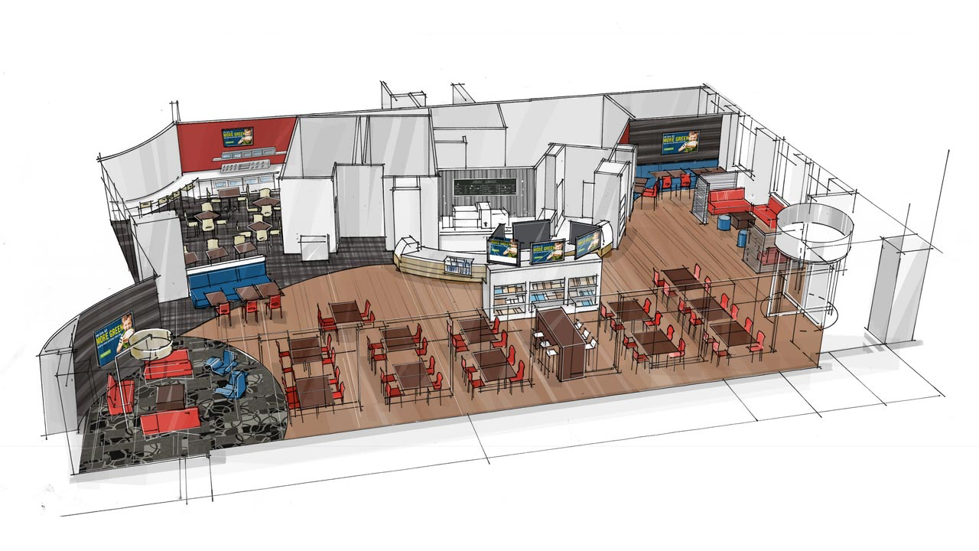


BUILDING THE CAPITAL ONE BRAND

Slide 3

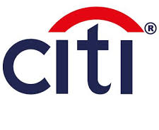



Beyond low industry growth, Capital One faces pressure from both consumers and competitors to innovate
CONSUMER PRESSURE
COMPETITIVE PRESSURE
Increasing Demand for
Multichannel Experiences
Convergence of Competition
on Multichannel Model
ATM only
5
Call only
5
Web only
10
Branch only
15
PERCENT OF
CUSTOMERS
Multichannel customers
65
Source: McKinsey

Slide 4
Beyond low industry growth, Capital One faces pressure from both consumers and competitors to innovate
CONSUMER PRESSURE
COMPETITIVE PRESSURE
Increasing Demand for
Multichannel Experiences
Convergence of Competition
on Multichannel Model
In the face of low industry growth, building loyalty
is the key to retaining existing relationships
and acquiring new relationships.
Strengthen
Customer Satisfaction
Increase
Net Promoter Score (NPS)
12% Increase in
Transaction Likelihood
Source: Bain & Company

Slide 5
Value Proposition
Leverage Capital One’s national lending products, the
Capital One 360 business, and its retail banking business to most
effectively sustain and grow its banking relationships in the US.
OBJECTIVE
Low Industry
Growth
Multichannel
Demands
Competitive
Encroachment
KEY ISSUES
CUSTOMER RETENTION
CUSTOMER ACQUISITION
RECOMMENDATIONS
360ne Expansion Model
Inspire Card & Network
Increased customer satisfaction and loyalty, enhanced customer
retention, and strengthened acquisition strategy will drive incremental
dividend payout of 25 cents over the next five years.
IMPACT

Slide 6
I. Enhancing Customer Retention
360
0ne
Expansion Model

Slide 7
Capital One must address three key drivers of customer satisfaction to sustain existing relationships
Low
Fees
Locational
Ubiquity
Customer
Service
Significant competitive
pressures exist to lower fees
or risk customer dissatisfaction.
As digital interactions increase, physical branches will increase in importance to consumers
Consumers still demand
human interaction for higher
value-added transactions.
Bank closures in US have reached
industry high since 2002
Online
Call
% of customers interacting with branch
0
2013
2,563
99
83
56
2012
2,518
2011
1,955
100
2010
2,445
44
1
17
Avg. # Web Interactions per Week
Balance
check
Funds
transfer
Fare
Inquiries
Issue
Resolution
Source: Wall Street Journal
Source: McKinsey
Source: McKinsey

Slide 8
360ne is a physical location strategy that enhances key drivers of satisfaction while lowering expansion costs
360ne leverages the ING Direct acquisition in a hub and spoke expansion
model with light-service cafes organized around flagship branches.
OVERVIEW
360ne
Hub and Spoke Expansion Model

Slide 9
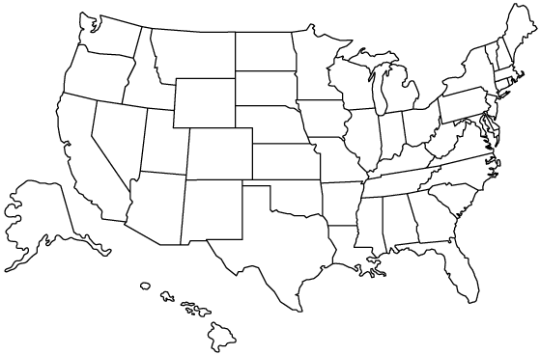

360ne is a physical location strategy that enhances key drivers of satisfaction while lowering expansion costs
360ne leverages the ING Direct acquisition in a hub and spoke expansion
model with light-service cafes organized around flagship branches.
OVERVIEW
EXECUTION
1
Target
2
Build
3
Integrate
Use competency of Information Backed Strategy (IBS) and geo-demographic modeling to evaluate and identify optimal target trade areas for establishment of each 360ne hub and spoke network.

Slide 10

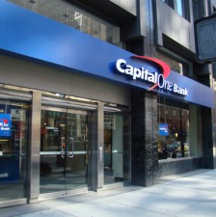
360ne is a physical location strategy that enhances key drivers of satisfaction while lowering expansion costs
360ne leverages the ING Direct acquisition in a hub and spoke expansion
model with light-service cafes organized around flagship branches.
OVERVIEW
EXECUTION
1
Target
2
Build
3
Integrate
Build one hub, or flagship branch, in a central location that will maximize trade area profits.
Flagship branches will offer the full range of Capital One national lending products.

Slide 11
360ne is a physical location strategy that enhances key drivers of satisfaction while lowering expansion costs
360ne leverages the ING Direct acquisition in a hub and spoke expansion
model with light-service cafes organized around flagship branches.
OVERVIEW
EXECUTION
1
Target
2
Build
3
Integrate
Build a network of smaller, light-service spoke branches to maximize physical ubiquity.
Spoke branches will retain the feel of Capital One 360 cafes and be equipped for integration with hubs.

Slide 12


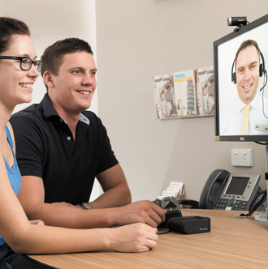
360ne is a physical location strategy that enhances key drivers of satisfaction while lowering expansion costs
360ne leverages the ING Direct acquisition in a hub and spoke expansion
model with light-service cafes organized around flagship branches.
OVERVIEW
EXECUTION
1
Target
2
Build
3
Integrate
Integrate full-service hubs with light-service spokes to ensure that customer needs can be met regardless of location
Cross-Trained
Employees
Appointment
System
Video
Conferencing

Slide 13
360ne is a physical location strategy that enhances key drivers of satisfaction while lowering expansion costs
360ne leverages the ING Direct acquisition in a hub and spoke expansion
model with light-service cafes organized around flagship branches.
OVERVIEW
IMPACT
1
2
3
Hub and spoke model decreases expansion
costs by utilizing assets
from ING Direct acquisition
Heightened physical
ubiquity better addresses consumer demand for
human interaction
Physical service capability strengthens legitimacy
of Capital One 360
direct brand

Slide 14
II. Strengthening Customer Acquisition
INSPIRE
Card & Family Network

Slide 15
How should Capital One approach new customer acquisition, and who should it target?
What are the top two drivers of customer acquisition?
Source: Bain & Company
Broad Product
Portfolio
Low Interest Rates &
Attractive Incentives
Consumers are more attracted to banks that
offer a broad range of products, allowing
them to fulfill their product needs in one place
Consumers prefer banks whose products have low interest rates and incentives
that closely align with their values

Slide 16
How should Capital One approach new customer acquisition, and who should it target?
What are the top two drivers of customer acquisition?
Source: Bain & Company
Broad Product
Portfolio
Low Interest Rates &
Attractive Incentives
Consumers are more attracted to banks that
offer a broad range of products, allowing
them to fulfill their product needs in one place
Consumers prefer banks whose products have low interest rates and incentives
that closely align with their values
Who should Capital One target?
Total New Retail Bank Business
22%
First-Time
Consumers
78% of total new retail bank business consists of switchers
78%
Switchers
Source: Bain & Company

Slide 17

How should Capital One approach new customer acquisition, and who should it target?
What are the top two drivers of customer acquisition?
Source: Bain & Company
Broad Product
Portfolio
Low Interest Rates &
Attractive Incentives
Consumers are more attracted to banks that
offer a broad range of products, allowing
them to fulfill their product needs in one place
Consumers prefer banks whose products have low interest rates and incentives
that closely align with their values
Who should Capital One target?
Total New Retail Bank Business
The Rising Mass Affluent
22%
First-Time
Consumers
31.5 years old
College educated
1.2 children on average
High discretionary income
Source: Gallup
78%
Switchers

Slide 18
How should Capital One approach new customer acquisition, and who should it target?
What are the top two drivers of customer acquisition?
Source: Bain & Company
Broad Product
Portfolio
Low Interest Rates &
Attractive Incentives
Consumers are more attracted to banks that
offer a broad range of products, allowing
them to fulfill their product needs in one place
Consumers prefer banks whose products have low interest rates and incentives
that closely align with their values
Who should Capital One target?
Total New Retail Bank Business
The Rising Mass Affluent
22%
First-Time
Consumers
13 million households
Liquid investable assets: $250k - $1m
Generates 60–70% of total bank profits
Source: Strategy&
78%
Switchers

Slide 19
Credit cards can be marketed to and aligned with customer values and serve as a gateway to the brand
What does the acquisition target value?
Family
Financial Responsibility
The rising mass affluent has often begun or is
beginning a family, with 1.2 children on average
“More frugal, more self-reliant, and more likely to save than other segments”
Source: Gallup
Source: Strategy&

Slide 20
Credit cards can be marketed to and aligned with customer values and serve as a gateway to the brand
What does the acquisition target value?
Family
Financial Responsibility
The rising mass affluent has often begun or is
beginning a family, with 1.2 children on average
“More frugal, more self-reliant, and more likely to save than other segments”
Source: Gallup
Source: Strategy&
Capital One should develop a tailored credit card to target this market. Why?
1
2
3
Unlike other products, credit cards facilitate marketing and creation of brand
Credit card incentives can
be tailored to align with the values of a target market
Credit cards serve as a
gateway to the full portfolio
of lending products

Slide 21


Capital One Inspire offers differentiated incentives and reinforces a brand focused on family
Capital One Inspire aligns incentives with the values of the rising mass
affluence and builds a differentiated brand for Capital One
OVERVIEW
INSPIRE

Slide 22
Capital One Inspire offers differentiated incentives and reinforces a brand focused on family
Capital One Inspire aligns incentives with the values of the rising mass
affluence and builds a differentiated brand for Capital One
OVERVIEW
1
Tailoring Incentives
2
Expanding
the Network
3
Building
a Brand
EXECUTION
INSPIRE
CARDHOLDER INCENTIVE
1.5% of all purchases will go to Capital One add-on CD account which can be used to pay for the cardholder’s child’s future college education

Slide 23


Capital One Inspire offers differentiated incentives and reinforces a brand focused on family
Capital One Inspire aligns incentives with the values of the rising mass
affluence and builds a differentiated brand for Capital One
OVERVIEW
1
Tailoring Incentives
2
Expanding
the Network
3
Building
a Brand
EXECUTION
Extended family and friends can support their future college student’s education by signing up for an Inspire card of their own
Parent
Extended
Family
Family
Friend
Expanding the network creates another opportunity for customer acquisition
INSPIRE
Add-On CD for Beneficiary

Slide 24

Capital One Inspire offers differentiated incentives and reinforces a brand focused on family
Capital One Inspire aligns incentives with the values of the rising mass
affluence and builds a differentiated brand for Capital One
OVERVIEW
1
Tailoring Incentives
2
Expanding
the Network
3
Building
a Brand
EXECUTION
INSPIRE
Family Network
Brand Values | Network Incentives
Community | Family fairs, investing seminars, community movie nights, and more
Financial Responsibility
Children’s Education
Notes:
Family Fairs, Investing Seminars, Community Movie Nights, and more

Slide 25
Capital One Inspire offers differentiated incentives and reinforces a brand focused on family
Capital One Inspire aligns incentives with the values of the rising mass
affluence and builds a differentiated brand for Capital One
OVERVIEW
IMPACT
1
2
3
The Inspire Credit Card captures a new growth market in consumer banking
The Inspire Family Network creates a channel of organic marketing for Capital One
Both card and network strengthen brand loyalty by reinforcing community values

Slide 26
Impact Summary
I. Enhancing Customer Retention
360ne
Repeat Transaction Likelihood
Capital
Expenditures
12% Increase
from NPS growth
30% Decrease
on a store-by-store basis
Users will be more loyal and choose not to switch from Capital One
Notes:
, decreasing the amount of “catch-up” work to maintain user base

Slide 27
Impact Summary
I. Enhancing Customer Retention
II. Strengthening Customer Acquisition
360ne
INSPIRE
Repeat Transaction Likelihood
Capital
Expenditures
Revenue
Projection
12% Increase
from NPS growth
30% Decrease
on a store-by-store basis
15 - 20% Increase
from stable organic growth
Users will be more loyal and choose not to switch from Capital One
Notes:
, decreasing the amount of “catch-up” work to maintain user base

Slide 28
Impact Summary
I. Enhancing Customer Retention
II. Strengthening Customer Acquisition
360ne
INSPIRE
Repeat Transaction Likelihood
Capital
Expenditures
Revenue
Projection
12% Increase
from NPS growth
30% Decrease
on a store-by-store basis
15 - 20% Increase
from stable organic growth
Users will be more loyal and choose not to switch from Capital One
Increased customer satisfaction and loyalty, enhanced customer
retention, and strengthened acquisition strategy will drive incremental
dividend payout of 25 cents over the next five years.
Notes:
, decreasing the amount of “catch-up” work to maintain user base

Slide 29
Q&A Period: Table of Contents
PRESENTATION SLIDES
ADDITIONAL CONTENT
Critical Issues
Loyalty is Key
Value Proposition
360ne Expansion Model
Customer Retention Drivers
Overview & Execution
Impact of Recommendation
Inspire Card and Network
Customer Acquisition Drivers
Identifying Acquisition Target
Using Credit Card to Target
Overview & Execution
Impact of Recommendation
Impact Summary
Implementation Timeline
Net Promoter Score (NPS)
Promoters Buy More
Push and Pull Drivers
Growth Imperative
360ne Expansion Model
Net Bank Closures 2013
Full-Service Downsizing Cases
Physical Will Remain Important
Shift of Branch Function
Service Offerings: Hub v. Spoke
Location Selection Criteria
Video Conferencing Case Study
Video Conf. Adoption by Young
Video Conf. Adoption by Older
Cross Training Case Studies
Inspire Card and Network
Bank Switcher Profile
Mass Affluent Profile
Inspire Leading Competitor
Differentiated from Current Cards
Community Branding Case Study
Risks and Mitigations
Financials
DPS with Recommendations
DPS without Recommendations
Cost Structure: Trad’nal v. Hub/Spoke

Slide 30
Implementation Timeline
Enhancing Customer
Retention
360ne
Identify target location
Negotiate term sheet
Continue to build physical presence
Build hub
Build spokes
2013
2014
2015
2016
2017
Strengthening
Customer
Acquisition
INSPIRE
Product rollout
Reassess customer needs
Building
Community
Brand
Redirect marketing spend
to community initiatives
Launch community events
Notes:
Minimal work necessary on the backend, product rollout can be immediate. Reassess after 2 years, realign needs of customers

Slide 31
Value Proposition
Leverage Capital One’s national lending products, the
Capital One 360 business, and its retail banking business to most
effectively sustain and grow its banking relationships in the US.
OBJECTIVE
Low Industry
Growth
Multichannel
Demands
Competitive
Encroachment
KEY ISSUES
CUSTOMER RETENTION
CUSTOMER ACQUISITION
RECOMMENDATIONS
360ne Expansion Model
Inspire Card & Network
Increased customer satisfaction and loyalty, enhanced customer
retention, and strengthened acquisition strategy will drive incremental
dividend payout of 25 cents over the next five years.
IMPACT

Slide 32
BUILDING THE CAPITAL ONE BRAND

Slide 33
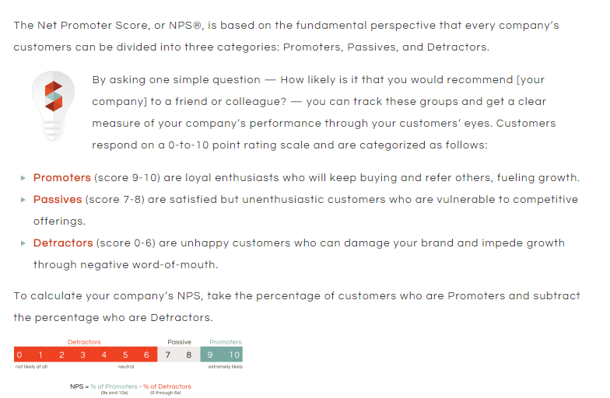
Appendix: What is Net Promoter Score (NPS)?

Slide 34
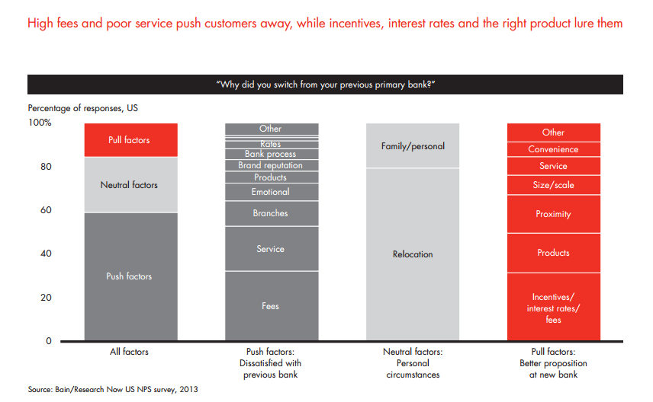
Appendix: Consumer Push and Pull Drivers

Slide 35
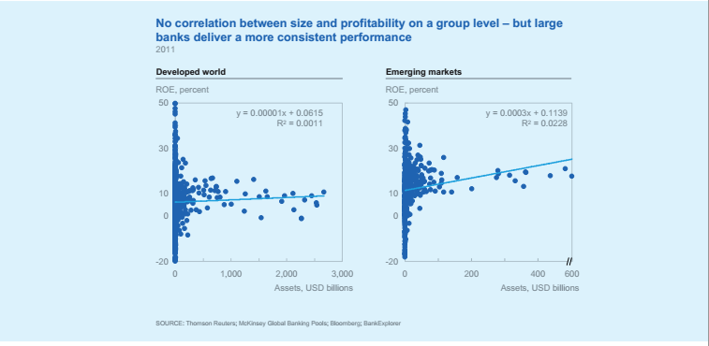
Appendix: Growing bank via assets and deposits
correlates directly with consistent performance

Slide 36
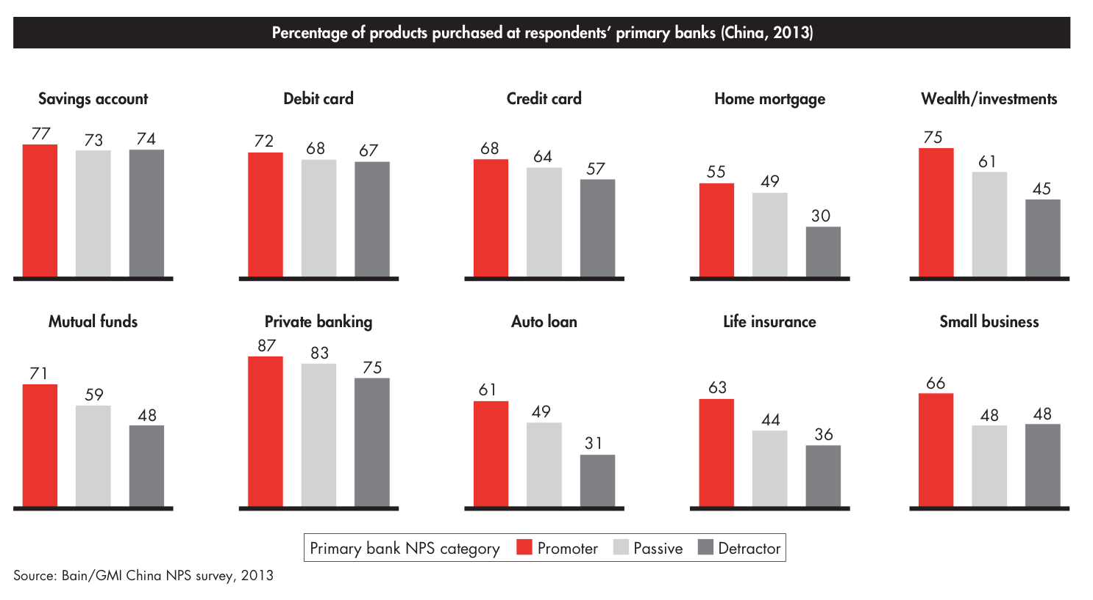
Appendix: Promoters Buy More

Slide 37
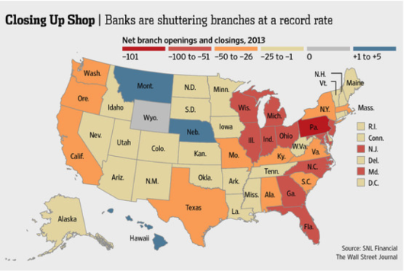
Appendix: Bank Closures 2013

Slide 38
Appendix: Full-Service Downsizing Cases
Bank of America has closed nearly 600 full-service branches over the past two years, and it looks like they plan to continue this trend.
JPMorgan Chase is using another method to downsize full-
service physical operations, choosing to keep the number of branches steady, but to make the actual buildings smaller,
with fewer employees.
Source: Wall Street Journal: Bank Downsizing

Slide 39
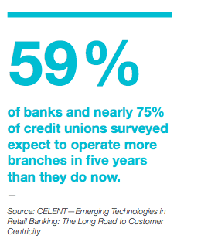
Appendix: Physical locations will remain important despite move toward online
Branch best meets consumers core rational needs of:
Access and convenience: Enables consumers to easily access broad array of products in reasonable distance from home
Face to face contact: 800 service number and 24 hour line have been around for years yet demand for physical location still grows due to desire for eye contact and face to face interaction with problem solvers
Branch best meets consumers’ core emotional needs of:
Comfort and security: Physical associations with security critical to emotional comfort of secure finances
Collaboration and belonging: Allows consumers to feel like they have more of a voice and association: “this is my bank”

Slide 40
Appendix: Shift of Branch Function
“Since consumers can perform simple, standard transactions on a mobile application, they will no longer be visiting a branch to deposit a check or transfer money from on account to another.
They will be coming to branches for more complex financial decisions such as requesting a mortgage.”
Mobile Commerce Daily, 2013

Slide 41
Appendix: Services Offered at Hubs v. Spokes
Full-Service Hub
Light-Service Spoke
Mortgages
Auto Loans
Home Equity
ShareBuilder
Retirement
Personal Banking
Small Business Banking
Commercial Banking
Personal Credit Card
Small Business Credit Card
Issue Resolution
Issue Escalation
Funds Transfer
Fee Inquiries
Open Accounts
Mortgage Resolution
Auto Loans Resolution
Issue Resolution
Video Conferencing
Self-Service Kiosks
Appointment Scheduling
Coffee Sales
Funds Transfer
Fee Inquiries
Card services

Slide 42
Appendix: Location Selection Criteria
Full-Service Hub
Light-Service Spoke
Pop. Size: ~150,000 in 3 mile radius
Average Income: Average of $75,000-$100,000 with ideal skewed distribution toward higher end
Distance from Hub: N/A
Strategic Proximity: Located near strong retail submarket without full integration
Pop. Size: ~60,000-70,000 in 3 mile radius
Average Income: Average of $75,000-$100,000 with ideal skewed distribution towards higher end
Distance from hub: 10-15 miles
Strategic Proximity: Integrated into strong retail markets, i.e. grocery plazas, malls etc.

Slide 43
Appendix: Video Conferencing Case Study
In Australia, the big four banks all now use video communications to boost customer service.
Commonwealth Bank of Australia (CBA) installed video-conferencing facilities across its 1166 branches last year, leveraging existing internal technology and dedicated high-speed internet lines. Customers can choose to be connected to specific bank specialists such as home and personal lenders, financial planners, business bankers, asset finance or merchant specialists, says Adam Bennett, CBA’s executive general manager of business banking.
“The interaction is extremely similar to what it would be like if the specialist was sitting next to the customer directly in the room,” he says.

Slide 44
Appendix: Video Conferencing Adoption by Young
Polycom and Redshift Research survey shows Video Conferencing Expected to be Preferred Business Communications Tool in 2016 and major takeaways:
96 percent of business managers and leaders say video conferencing helps companies defy distance and break down cultural barriers to improve productivity
83 percent of respondents, and almost 90 percent of those in their 20s and 30s, use consumer video conferencing solutions at home today.
76 percent of respondents use video solutions at work today, and 56 percent of video conferencing users participating in at least one video call a week
Notes:
, decreasing the amount of “catch-up” work to maintain user base

Slide 45
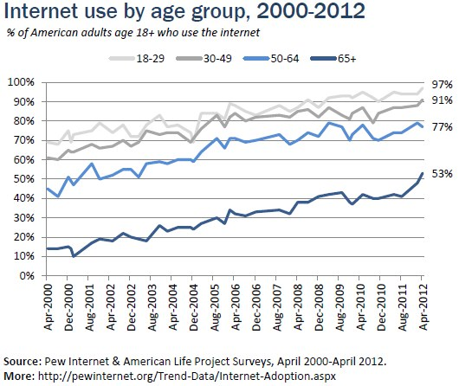
Appendix: Video Conferencing Adoption by Older
Definitive upwards trend
for digital literacy
77% of people age 50-64 are using the internet, signifying a comfort level with basic
digital technology
Notes:
, decreasing the amount of “catch-up” work to maintain user base

Slide 46
Appendix: Cross Training Cost Savings Case Studies
Government service agency
(Parry, 1996)
Bank supervisors
(Mathieu & Leonard, 1987)
Agency training program of $95,000 resulted in cost savings of $670,000
Cross training supervisory skills resulted in cost savings of $149,000 over 5 years
Based on prior case studies, cross training government service agents or bank supervisors resulted in a 50%-75% increase in cost savings beyond initial investment
Source: Applied Human Resource Management
Notes:
, decreasing the amount of “catch-up” work to maintain user base

Slide 47
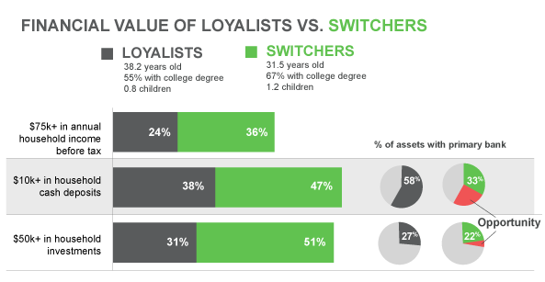
Appendix: Bank Switcher Profile
Source: Gallup, Customers Who Switch Banks Are Too Valuable to Lose (2013)

Slide 48
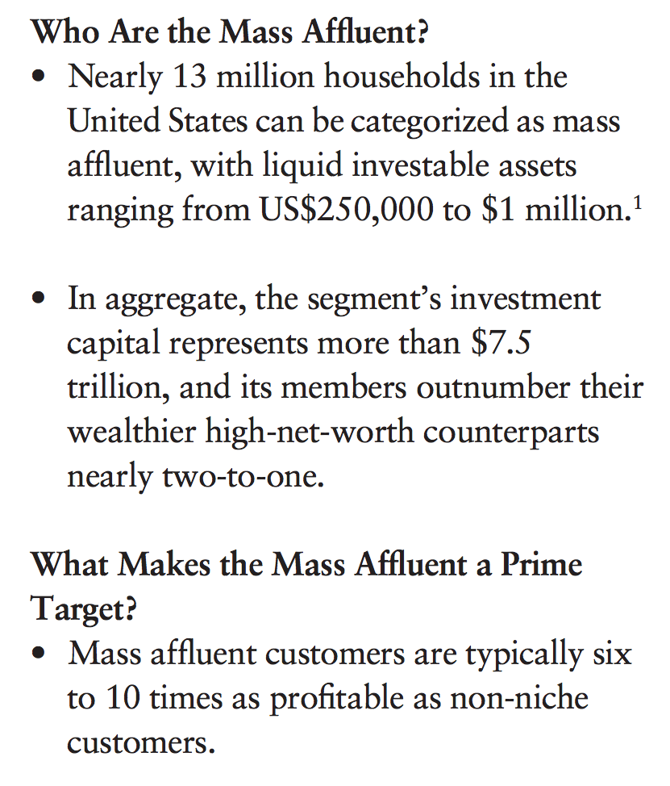
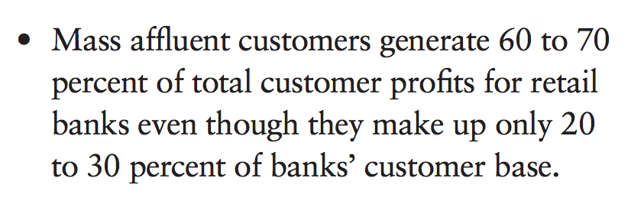
Appendix: Rising Mass Affluent Profile
Source: Strategy&

Slide 49
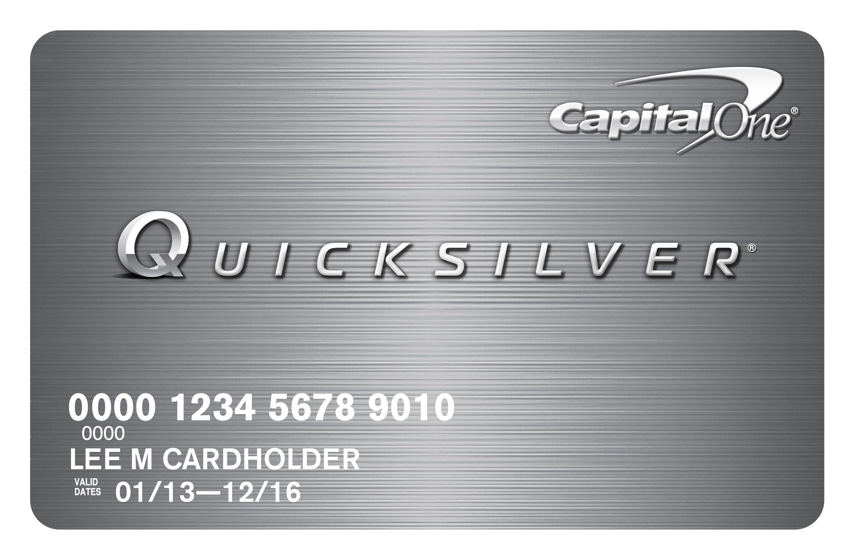
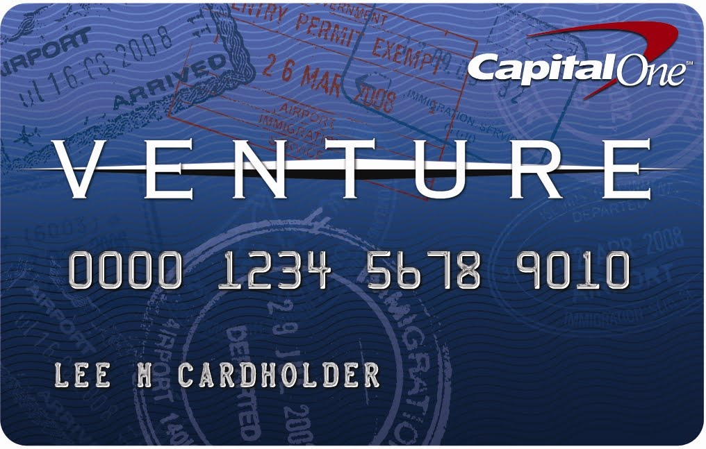
Appendix: Inspire will not cannibalize current offerings
Unlimited 1.5% cash back on every purchase
No annual fee
One time $100 bonus when spend $500 on purchases in the first 3 months
Credit Tracker to easily monitor credit score
0% intro APR, and 12.9-22.9% variable after
Unlimited 2 miles per dollar on every purchase
One time bonus of 40,000 miles once spend $3,000 within first 3 months
Fly any airline, stay any hotel any time
No foreign transaction fees
Credit Tracker to easily monitor credit score

Slide 50
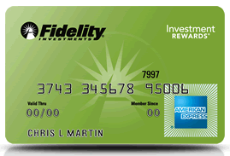
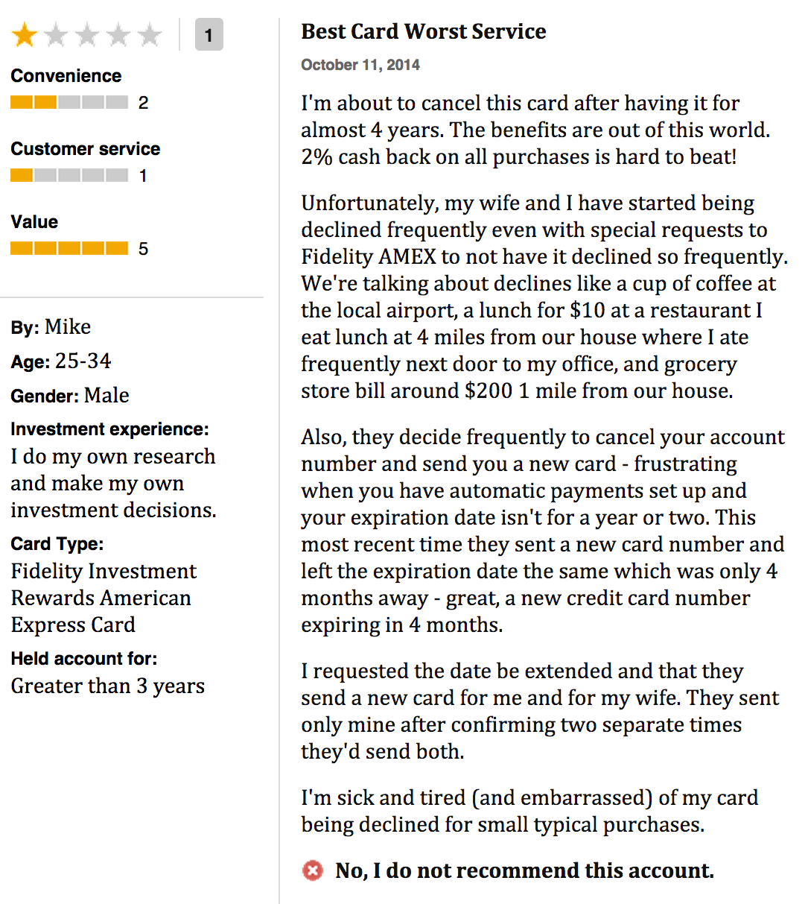
Appendix: Inspire Leading Competitor
American Express Fidelity
What it offers
How Capital One Inspire differs
The Fidelity Investment Rewards American Card offers cash-back with the option to deposit rewards into various Fidelity accounts
Capital One will offer a deposit into an add-on CD rather than a 529 which might have high service fees or reduce a student’s eligibility for financial aid; CDs are also FDIC insured
Source: https://www.fidelity.com/cash-management/american-express-cards

Slide 51
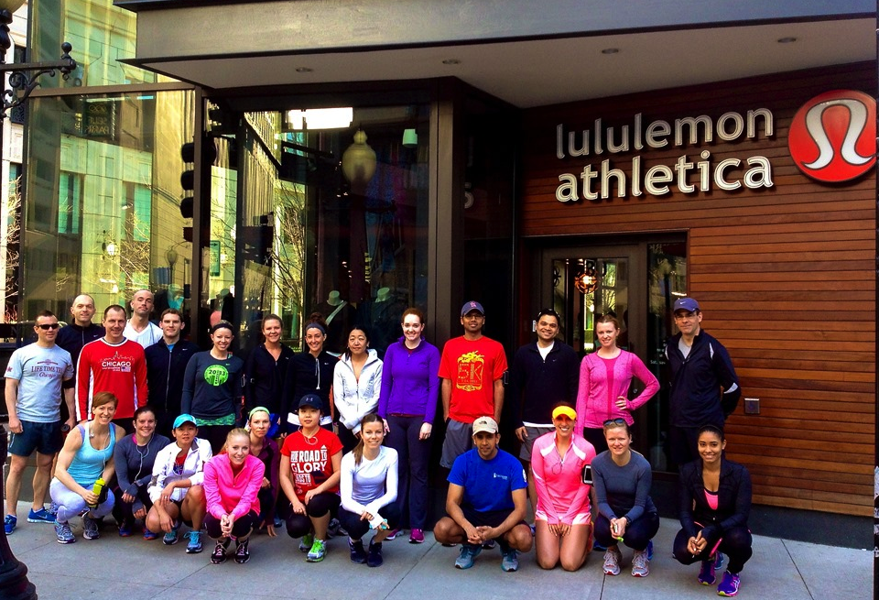
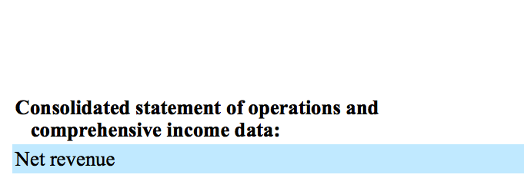
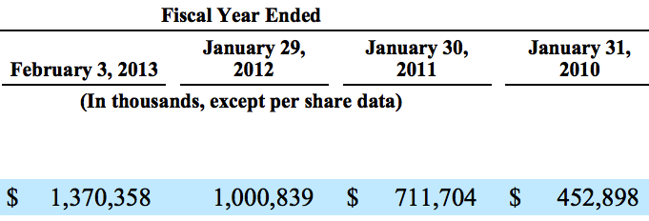
Appendix: Lululemon Athletica Case Study
Strengthening bottom line by enacting community values
Premise
Impact
Lululemon offers “run clubs” multiple times a week to encourage store patrons to socialize outside of shopping
Resulted in a stronger sense of community and generated positive publicity through social media activity
Source: 2013 Annual Report

Slide 52
Appendix: Risk Mitigation
Risk | Mitigation
Competitors will imitate the Inspire card | Capital One’s first mover advantage in developing a new type of banking brand ensures that competitors are seen as imitators with inferior offerings
The spokes will be unable to fully service the needs of customers | Implement a series of technological and in-person systems and back-ups to ensure that spokes can address all needs
Inspire community events will drastically increase our sales and marketing expenses, resulting in lower profits. | Redirect some budget-making decision power to the local level, increasing responsiveness to local opportunities

Slide 53
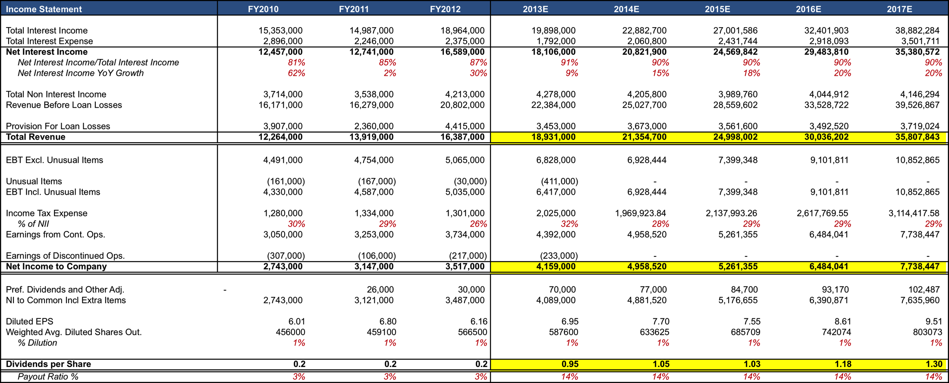
Appendix: Dividends per Share Effect with Recommendations

Slide 54
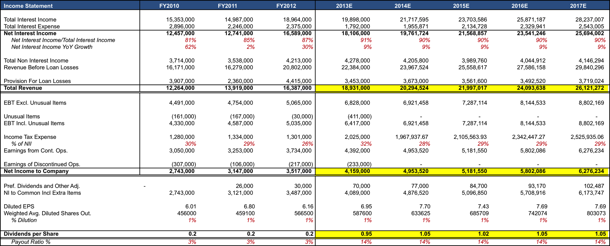
Appendix: Dividends per Share Effect without Recommendations

Slide 55
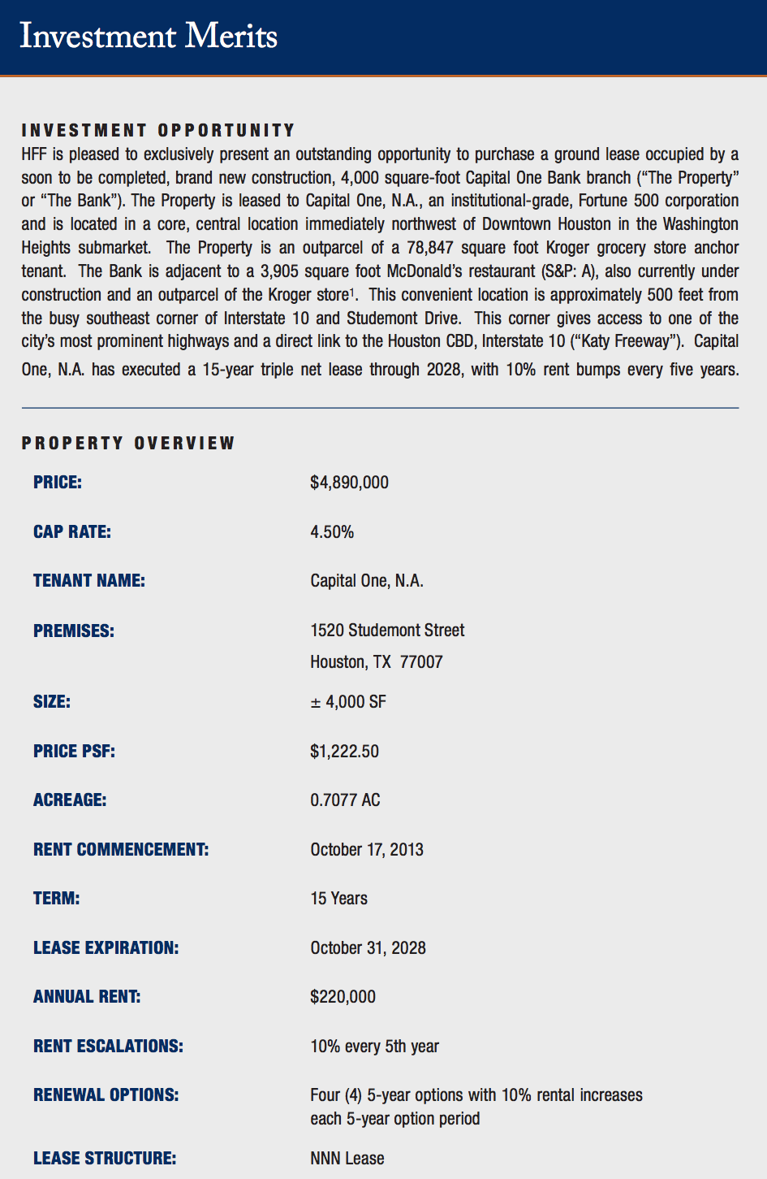
Appendix: Comparing Cost Structures
Traditional v. Hub and Spoke Expansion
Existing Expansion Model
Expand through the opening of retail locations as self operating bank branches
Average cost of $5 million for 4000 square feet
360ne Expansion Strategy
Expand through the opening of spokes (cafes) that average 1000-2000 square feet
Could potentially be operated in shopping malls and less conventional areas
Reduction in property prices of 66%, allowing for the opening of multiple spokes while still decreasing capital expenditure costs by 20-30%
Source: Holliday Fenoglio Fowler (HFF) Confidential Investment Memorandum for Capital One

Slide 56
Appendix: Bank Switcher Profile
Source: Gallup, Customers Who Switch Banks Are Too Valuable to Lose (2013)

Slide 57
Appendix: Inspire will not cannibalize current offerings
Unlimited 1.5% cash back on every purchase
No annual fee
One time $100 bonus when spend $500 on purchases in the first 3 months
Credit Tracker to easily monitor credit score
0% intro APR, and 12.9-22.9% variable after
Unlimited 2 miles per dollar on every purchase
One time bonus of 40,000 miles once spend $3,000 within first 3 months
Fly any airline, stay any hotel any time
No foreign transaction fees
Credit Tracker to easily monitor credit score

