Slide 1
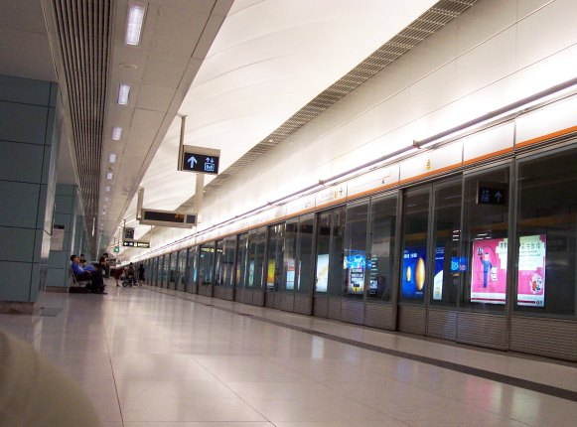
OCTOPUS: 8 LEGS OF DOMINANCE
Kevin Chang | Ryan Kim | Sida Lu | Kenneth Shih

Slide 2

The microtransaction business depends on its ability reach a wide amount of spending consumers
Microtransaction companies produce of a bulk of their
revenue from transaction fees, taking a percent from the company with each consumer usage
FREQUENCY
Increase the amount of purchases each consumer makes
SCALE
Establish a wider footprint attract more customers to use the system
CONVENIENCE
Available to fit the lifestyles of consumers and act as a preferred payment method
Frequency, scale, and convenience are all interrelated factors that drive Octopus’s
ability to earn higher revenues

Slide 3
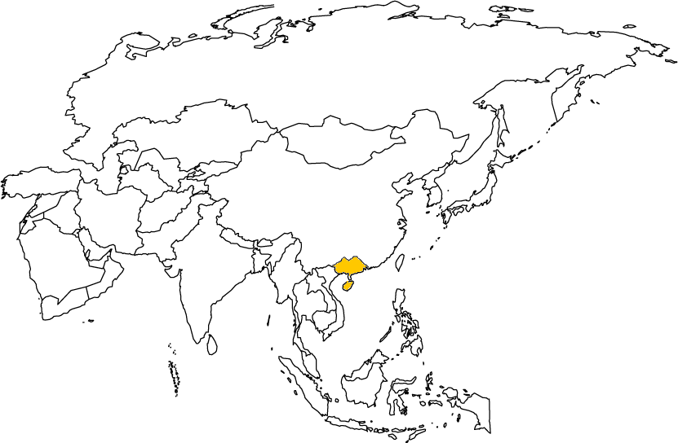

Octopus is losing its advantages gained from being a first mover, and must seek alternative methods to grow

Slide 4
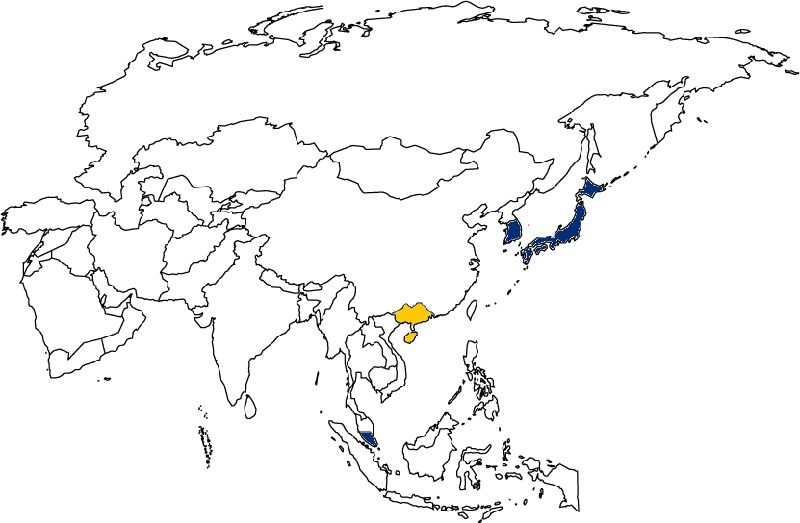
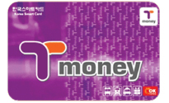
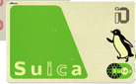
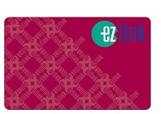
Octopus is losing its advantages gained from being a first mover, and must seek alternative methods to grow

Slide 5
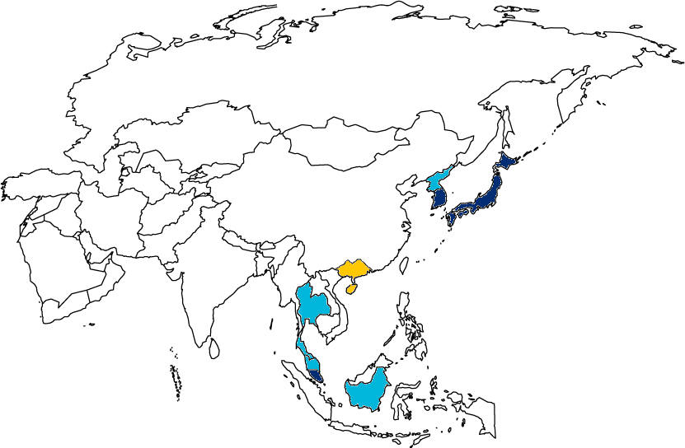
Octopus is losing its advantages gained from being a first mover, and must seek alternative methods to grow

Slide 6
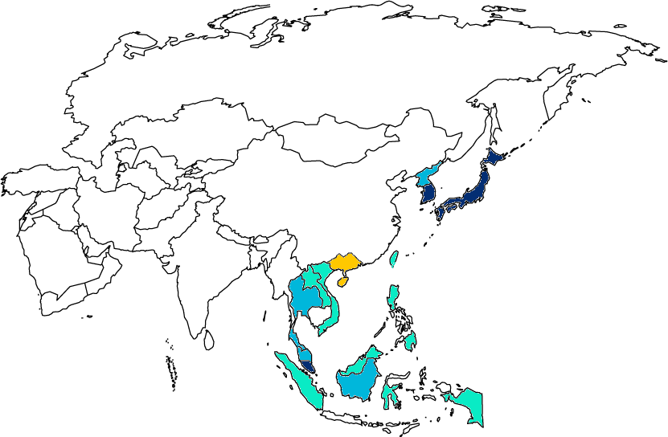
Octopus is losing its advantages gained from being a first mover, and must seek alternative methods to grow
Octopus has already saturated the Hong Kong market, and needs to expand to new markets in order to sustain itself against increasingly competitive players

Slide 7


The key issue Octopus faces when looking for places to expand is a lack of customer demand and technological infrastructure
If customers don’t have an Octopus card, businesses have no incentive to support the infrastructure
If business doesn’t’ support Octopus payment, no incentive for customers to have a card

Slide 8
Value Proposition
OBJECTIVE
How can Octopus expand and grow for the next 10 years while considering this vicious cycle?
KEY ISSUES
Market Saturation
Growing Competition
Technological Advancements
STRATEGY
Geographic Expansion
P2P and B2P
IMPACT
Sustained competitive advantage
Increased global presence

Slide 9
1. Geographic Expansion
2. P2P and B2P

Slide 10
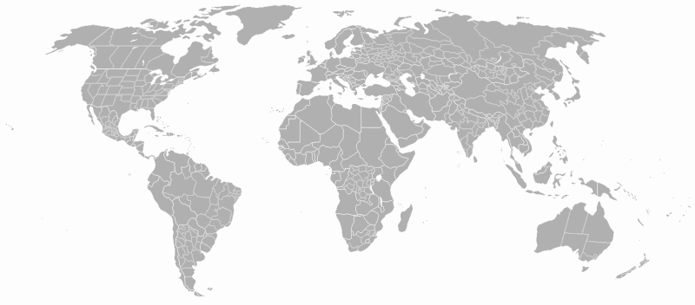
CRITERIA
Cultural & Geographic Fit

Slide 11
CRITIERA
CRITERIA
Cultural & Geographic Fit
Cultural & Geographic Fit
Infrastructure Similarities

Slide 12
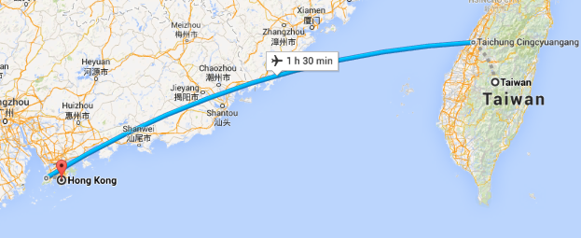
CRITIERA
CRITIERA
CRITERIA
Cultural & Geographic Fit
Cultural & Geographic Fit
Infrastructure Similarities
Cultural & Geographic Fit
Infrastructure Similarities
Permeability
Corporate Relationships

Slide 13
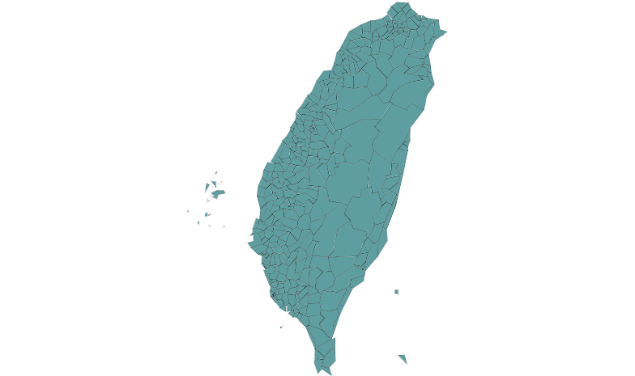
With near perfect criteria match, Taiwan is the ideal initial market for Octopus to adapt to
CRITIERA
Cultural & Geographic Fit
440 Miles away- Roughly the distance of San Francisco to Los Angeles
Chinese origin with developed Western tendencies
Infrastructure Similarities
Dominant MRT system, presence of buses, trains, and high speed rail
Permeability
40 flights a day– over 5 million people per year
Corporate Partner Presence
7-11 most popular convenience chain-5th most in the world
Over 5000 stores- huge reach

Slide 14
With near perfect criteria match, Taiwan is the ideal initial market for Octopus to adapt to
CRITIERA
Cultural & Geographic Fit
440 Miles away- Roughly the distance of San Francisco to Los Angeles
Chinese origin with developed Western tendencies
Infrastructure Similarities
Dominant MRT system, presence of buses, trains, and high speed rail
Permeability
40 flights a day– over 5 million people per year
Corporate Partner Presence
7-11 most popular convenience chain-5th most in the world
Over 5000 stores- huge reach

Slide 15
Taiwan presents strategic positioning for Octopus to leverage for future global growth
CRITIERA
FUTURE OPPORTUNITIES
Cultural & Geographic Fit
440 Miles away- Roughly the distance of San Francisco to Los Angeles
Chinese origin with developed Western tendencies
Infrastructure Similarities
Dominant MRT system, presence of buses, trains, and high speed rail
Permeability
40 flights a day– over 5 million people per year
Corporate Partner Presence
7-11 most popular convenience chain-5th most in the world
Over 5000 stores- huge reach
Beachhead for Chinese Market
Strong Western Relationship for Future Leverage
Projected huge growth and increased trade potential
Saturation in fast globalizing country

Slide 16
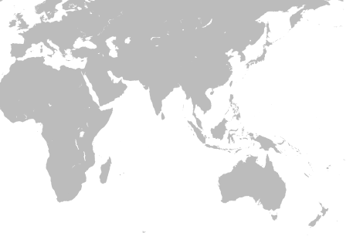

Slide 17
Taiwan is the first step in a series of expansion plans- “Leapfrog Strategy”
Seoul, South Korea
ShangHai, China
Hong Kong
Kuala Lumpur, Malaysia
Singapore
Jakarta, Indonesia

Slide 18
Taiwan is the first step in a series of expansion plans- “Leapfrog Strategy”
Seoul, South Korea
ShangHai, China
Hong Kong
Kuala Lumpur, Malaysia
Singapore
Jakarta, Indonesia

Slide 19
1. Geographic Expansion
2. P2P and B2P

Slide 20

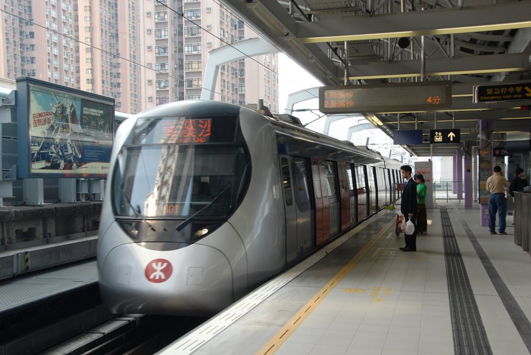
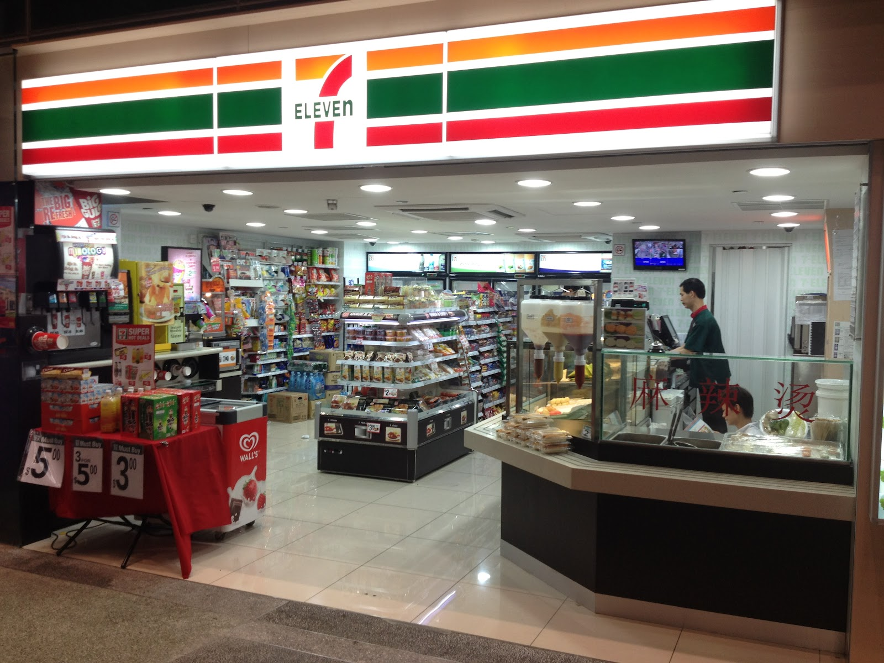
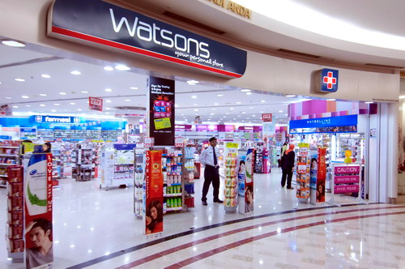
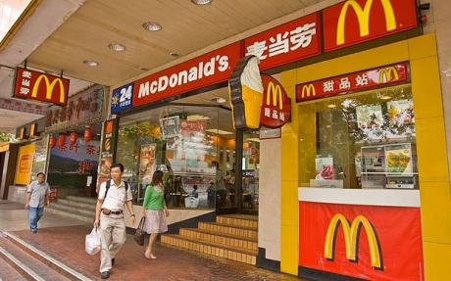
Introducing P2P payment services will sustain revenue growth
The Octopus P2P system will allow individuals to exchange small amounts of funds between one another.
This would be both an offensive and defensive strategy that would only require a marginal start-up cost of $7.76 million HKD.

Slide 21

B2P payment systems would further strengthen the Octopus ecosystem
Traditional Payroll:
Octopus B2P Payroll:
Companies pay their employees with paychecks/direct deposit.
Employees cash their paychecks or directly receive cash.
Employees spend the cash.
Key Takeaway: No Benefit to Octopus
Companies offer to pay their employees with traditional methods or with Octopus card credit.
Employees spend the Octopus card credit.
Octopus capitalizes on the spread between rebates and transaction fees.
Example Scenario:

Slide 22
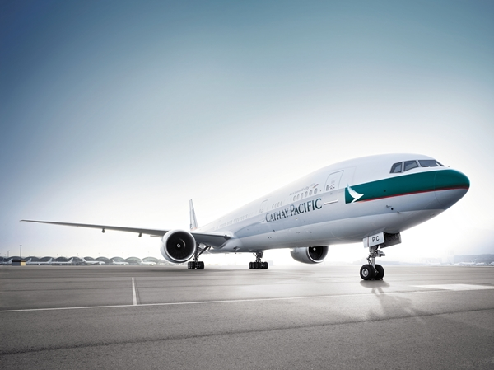


B2P payment systems would provide benefit for the entire value chain
Cathay Pacific offers their employees Octopus credit or a traditional paycheck
Value Add: The company receives a cash rebate when issuing payroll to employees
Cathay Pacific employees can receive their payroll in the form of Octopus credit
Value Add: Octopus is a widely accepted form of payment with multiple incentives
Octopus receives transaction fees when employees utilize the card
Value Add: The company receives transaction fees when employees utilize the card

Slide 23
B2P payment systems would provide benefit for the entire value chain
Both the P2P and B2P strategies will help Octopus increase the:
Frequency of transactions
Scale of its customer base
Ubiquity and accessibility to customers
Cathay Pacific offers their employees Octopus credit or a traditional paycheck
Value Add: The company receives a cash rebate when issuing payroll to employees
Cathay Pacific employees can receive their payroll in the form of Octopus credit
Value Add: Octopus is a widely accepted form of payment with multiple incentives
Octopus receives transaction fees when employees utilize the card
Value Add: The company receives transaction fees when employees utilize the card

Slide 24
Implementation Timeline
Leverage Existing
Partnerships and Competencies
Stage 1
Expansion to Taiwan
Target New
Retailers
Stage 2
Expansion to Other Countries
Target and Enter
New Markets
Y1
Y2
Y3
Y4
Y5
Y6
Y7
Y8
Y9
Y10
P2P
R&D
Rollout
B2P
Execute
in HK
Evaluate, Adjust Rates,
Target New Markets

Slide 25
Risks and Mitigations
Risk
Expansion to Taiwan represents diversion of capital and human resources from home market
Employees are disinterested in Octopus as a form of reimbursement
Businesses circumvent B2P contracts by acting in a P2P capacity
Mitigation
Reinvest earnings from Taiwan to bolster services in Hong Kong market
Work with retailers
to offer discounts, loyalty programs,
and other incentives to increase attractiveness
Cap maximum P2P payment system at a threshold above which transaction fees are imposed

Slide 26
Value Proposition
OBJECTIVE
How can Octopus expand and grow for the next 10 years while considering this vicious cycle?
KEY ISSUES
Market Saturation
Growing Competition
Technological Advancements
STRATEGY
Geographic Expansion
P2P and B2P
IMPACT
Sustained competitive advantage
Increased global presence

