Slide 1

Hui Fang Goes Global –
Group Case Assignment
MOR 492: Global Strategy
Fall 2014
Team 7: C. Huang, S. Khosla, T. Leong, C. Nguyen, S. Lu and L. Will
Los Angeles, December 1, 2014
Carl W. Voigt, Ph.D.
University of Southern California
Marshall School of Business

Slide 2
We recommend to enter Japan as we expect benefits as in the US at lower risk – greenfield plus premium brands suitable
Executive summary
  Please find our industry analysis, internal analysis, global strategy, and recommendations summarized here:
  Industry analysis: We analyzed market, competitive, cost and governmental drivers. The global cosmetics market is to increase by 24% until 2019 to reach $316 mn – skin and haircare plus cosmetics are crucial. While Europe and North America comprise 61% of the market, sales mainly channel through supermarkets and pharmacies. Capturing global growth and tailoring the offering to changing customer needs through R&D is key in cosmetics to date. Within this industry, buyers have the most negotiation power because they have many competitor products to choose from. Brand importance lowers threat of entry, however, the industry is globalizing with some substitutes available. The top 5 global players account for more than 45% of sales in the market - P&G, L’Oréal, and Unilever leading. With 49% of sales, COGS are a key cost driver followed by marketing (14%), wages (10%), and R&D investments (6%). Country-specific regulations in the global cosmetics industry vary wildly and are increasing – US legal issues moderate
  Internal analysis: Operations abroad should exploit Hui Fang’s transferable key assets: strong R&D, value-for-money organic products, and diversity; Soft Silk, Yore Sky, and Eshine have the highest potential in international markets due to their broad target groups
  Global strategy: We derived our entry recommendation by analyzing Hui Fang’s globalization rationale, key success factors, and countries. There are distinct reasons to consider globalization in order to reach the scale efficiencies major incumbents enjoy. Competitors from Japan and South Korea have been successfully in going global – Tactics Hui Fang can adopt, too. Considering lower-risk markets as Japan does not trade-off the benefits of access to high technology. The market evaluation included all factors that are crucial for a holistic high-quality comparison. The US market differs highly from the Chinese market, mainly due to cultural and geographic aspects but also legal issues – the investment case for Japan is NPV-positive; however, NPV is highly sensitive to key inputs.
  Recommendations: We recommend entering Japan as the same strategic benefits come with higher NPV. The decision tree focuses on how to enter the Japanese – or US – market in terms of entry mode, product, and channel. Due to high economic opportunity in Japan, we recommend to establish greenfield operations for Soft Silk and Yore Sky
Sources: Team analysis

Slide 3




We use a 4-step approach in order to derive answers to key questions and to grant strategic recommendations
Project approach
Recommendations
Global strategy
Internal analysis
Industry analysis
  Provide answers to key questions asked
  Derive recommendations for success abroad
  Suggest entry mode for selected market
  Understand Hui Fang’s global strategy
  Evaluate differences between countries
  Analyze crucial factors for success abroad
  Assess the market and its driving factors
  Understand the industry and the competition
  Analyze cost structures and government policies
  Evaluate Hui Fang’s key success factors
  Assess resources and capabilities
  Check brands for their international potential
Sources: Team analysis

Slide 4
Industry analysis
Project approach
Recommendations
Global strategy
Internal analysis
Industry analysis
  Provide answers to key questions asked
  Derive recommendations for success abroad
  Suggest entry mode for selected market
  Understand Hui Fang’s global strategy
  Evaluate differences between countries
  Analyze crucial factors for success abroad
  Assess the market and its driving factors
  Understand the industry and the competition
  Analyze cost structures and government policies
  Evaluate Hui Fang’s key success factors
  Assess resources and capabilities
  Check brands for their international potential
Sources: Team analysis

Slide 5
The subsequent industry analysis addresses all questions of market, competitive, cost and governmental drivers
Industry analysis
Market drivers
  How large is the global market?
  Is it growing comparatively strong?
  Which segments are important?
  Which factors mainly drive demand?
Competitive drivers
Cost drivers
  How strong are the competitive forces?
  Are suppliers and buyers powerful?
  Are there substitutes or entry barriers?
  How are the key players positioned?
  Which cost positions are the largest?
  What is the underlying rationale?
  What is the resulting profit and why?
  Which implications can be derived?
Integration
Governmental drivers
  To what extent do politics influence
    … market conditions?
    … competition?
    … underlying costs?
Sources: Team analysis

Slide 6
The global cosmetics market will increase by 24% to reach $316 MM in 2019 – skin and haircare plus cosmetics crucial
Market size and product segmentation
Global cosmetics market [$ mn]
Segmentation by product category [$ mn]
+24%
11
12
13
14
15
16
17
18
19
2014
Skin
Hair
Csmtcs
Frag
BS&D¹
Other
  For the next 5 years, overall strong industry growth of 24% expected despite the maturity in developed markets
  Developed market demands stimulated by effective new product introductions and marketing (e.g. natural lines)
  Global players focusing on underserved new markets as well as on aspirational shoppers² / the middle class
  Most cosmetic products within skin care, hair care, as well as cosmetics or fragrances (>80% of the market)
  Strong regional differences exist – skin care for example with 26% in Europe and with 43% in Japan
  Especially skin care and fragrances with accelerated recent growth – hair care highly mature
1) Bath, shower & deodorants 2) Shoppers who seek designer names but spend less than $300 per purchase
Sources: Team analysis, IBISWorld Industry Report “Global Cosmetics Manufacturing” (July 2014)

Slide 7
While Europe and North America comprises 61% of the market, sales mainly channel through supermarkets and pharmacies
Segmentation by regions and distribution channels
Segmentation by regions [%]
Segmentation by distribution channel [%]
Other
South America
12%
10%
36%
Europe
North Asia
18%
25%
North America
2014
Smkt¹
Phar²
Spcl³
Dptmt⁴
Spas
Direct
  Historical concentration among Europe, North America, and North Asia with US and Japan as key countries
  European market, consisting of 5 key counrires, served by mainly regional small- and medium-sized (SMEs)
  Strongest growth is from emerging markets that are still small in size (Latin America and Asia)
  Grocery stores, including supermarkets, are the largest sales channel in Europe, APAC, and Latin America
  Convenience expected to push the importance of grocery stores as well as department stores
  Sales via specialty stores has recently fallen – e-commerce impacting availability of hard-to-find items
1) Grocery stores and supermarkets 2) Pharmacies 3) Specialty cosmetics and personal-care stores 4) Department stores
Sources: Team analysis, IBISWorld Industry Report “Global Cosmetics Manufacturing” (July 2014)

Slide 8
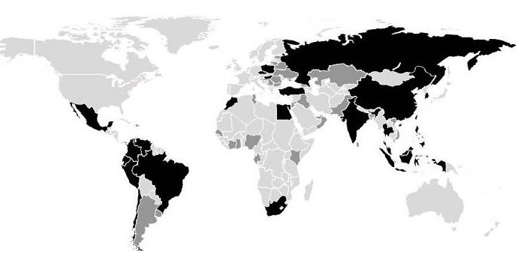



Capturing global growth and tailoring the offering to changing customer needs through R&D is key in cosmetics to date
Market drivers and trends
Key external drivers
Implications
  GDP of BRIC nations is growing and thereby consumer purchasing power
  Global per capita income is increasing and impacting the buying behavior
  R&D funding on global scale creates constantly new beauty products
  World crude oil price drives costs as main input for operations and products
  Behavior of Generation Y – consumers b/w 15 and 34 – influences prestige needs
  Desire for natural cosmetics increasing as well as for fair trade and others
  Consider emerging markets first
  Examine sources of global growth
  Pursue focus on R&D leadership
  Manage sourcing risk effectively
  Target youth lead users efficiently
  Investigate potential of natural lines
Sources: Team analysis, IBISWorld Industry Report “Global Cosmetics Manufacturing” (July 2014)

Slide 9
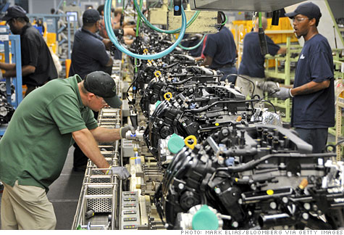
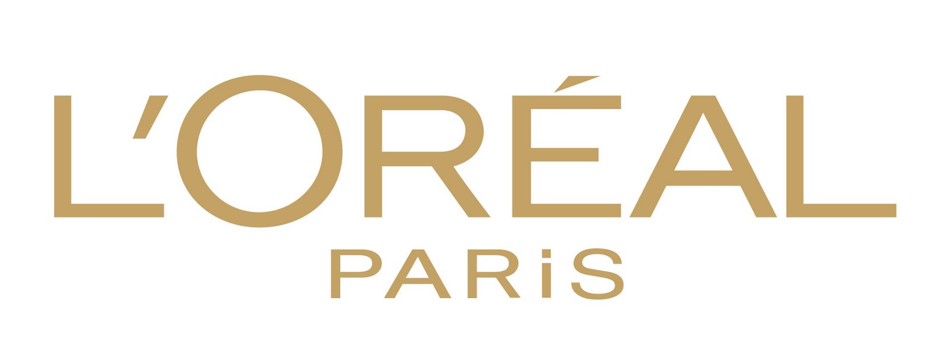




Within this industry, buyers have the most negotiation power because they have many competitor products to choose from
Competitive forces (1/2)
Supplier negotiation power
Competitor rivalry
Buyer negotiation power
  Suppliers reduce profitability by increasing price or decreasing output
  Firms must establish a good relationship with manufacturers and distributors in order to get the best products at the lowest price
  Due to the high number of suppliers, consumers have the power to influence the market prices as opposed to the suppliers
  Everyday use and low-cost items are highly undifferentiated so price can lead downstream buyers to choose one brand over another
  In high-quality niche products, consumers purchase base on promised performance
  Branding is the major basis for global market competition especially mega brands
  Cosmetic and personal care product manufacturers compete against wholesalers and retailers
Customers are becoming more aware of what goes in their products with the growing trend towards more natural and organic products
If buyers are not satisfied with the product or price, they will immediately purchase another one from a competitor
Although there is some degrees of brand loyalty, customers usually don’t stick to only one brand and will try new things
Sources: Team analysis, IBISWorld Industry Report “Global Cosmetics Manufacturing” (July 2014)
Notes:
Home remedies for skin care products can substitute store and brand products
If consumers are not satisfied with a certain product or prices are too high, they will look for alternative products from other competitors
Innovation is a key part within this industry so consumers are always looking for the latest product that will meet their needs

Slide 10



Brand importance lowers threat of entry, however, the industry is globalizing with some substitutes available
Competitive forces (2/2)
New entrants threat
Substitutes threat
Globalization of industry
  To be price competitive, new entrants will need substantial capital investments to achieve economies of scale
  Access to distribution network to compete with larger firms who have relationships with major wholesalers, distributors, suppliers and customers
  Advertising and establishing a brand name is important for consumers to adopt a new or unknown brand
  Home remedies for skin care products can substitute store and brand products
  If consumers are not satisfied with a certain product or prices are too high, they will look for alternative products from other competitors
  Innovation is a key part within this industry so consumers are always looking for the latest product that will meet their needs
  This industry is dominated by global players such as P&G, L’Oreal, and Unilever
  Many industry players rely on imports and exports to strengthen their grasp on the industry (avg. rate of 5.4%)
  High level of globalization exposes industry to global conditions such as fluctuations in exchange rate, supply levels and socio-political factors
Sources: Team analysis, IBISWorld Industry Report “Global Cosmetics Manufacturing” (July 2014)
Notes:
This industry is dominated by global players such as P&G and L’Oreal
In 2014, 37.8% of industry players were foreign-owned and expected to generate 59.5% of total industry revenue
International groups are entering the region with advanced technology and management
Domestic players have to improve product qualities and equipment to compete with foreign players

Slide 11
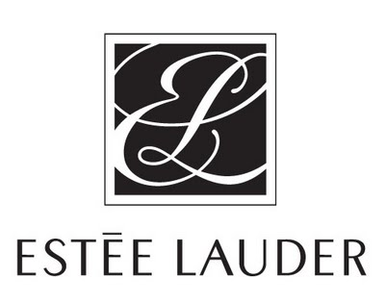
The top 5 global players account for more than 45% of sales in the market - P&G, L’Oréal, and Unilever leading
Key players
Global player
Competitive positioning
  Operates in over 180 countries with revenue primarily coming from retail operations through mass merchandisers, drug stores and grocery stores
  Growth strategy: (1) product innovation, (2) building business with underserved customers whose needs are not met through current products, (3) global development and expansion
  Largest cosmetic enterprise globally (also in China); operates in three separate segments: cosmetics, The Body Shop, and dermatology with cosmetics accounting for 93% of total revenue
  Offers a diverse product mix, value priced and luxury items, in over 130 countries
  Invests $1 billion annually to R&D to maintain their reputation
  One of the largest consumer goods manufacturer in the world in over 190 countries
  Company’s strategic priority of encouraging premiumization to drive growth with premium and innovative products to widen their range of customers
  Currently marketed in 89 countries and regions with its brand strategy of accelerating globalization
  Interested in expanding its presence in developing markets – Brazil, India, Tunisia and Argentina
  Specializes in premier manufacturing and marketing of luxury skin-care and hair-care products, makeup and fragrances (most profitable segment is skin care with devotion to men’s skin care)
  Investing heavily in marketing and R&D to expand presence in China, the Middle East, Eastern Europe and Brazil
Sources: Team analysis, IBISWorld Industry Report “Global Cosmetics Manufacturing” (July 2014)

Slide 12
With 49% of sales, COGS are a key cost driver followed by marketing (14%), wages (10%), and R&D investments (6%)
Industry cost structure
Breakdown of average player cost components in % of revenue
Implications
100.0
49.3
  Changes in raw materials are crucial, thus pursue cost-saving long-term relationships with suppliers
  Reduce packaging costs by in-housing or outsourcing to third party operators (conduct make-or-buy)
  Input costs are highly dependent on the price of crude oil, hence enter into commodity futures
  Send products to a centralized quality inspection and control before shipping to end consumers
  R&D costs have been increasing, i.e. centralize overall R&D efforts for further economies of scope
  With 14% of sales marketing is very important and suggests the need for local adaptation abroad
Marketing (14.0%)
Wages (10.1%)
R&D (6.2%)
Rent & Utilities (4.6%)
34.9
3.3
1.2
11.3
Revenue
COGS
SG&A
Depreciation
Other
Profit
Sources: Team analysis, IBISWorld Industry Report “Global Cosmetics Manufacturing” (July 2014)

Slide 13



Country-specific regulations in the global cosmetics industry vary wildly and are increasing – US legal issues moderate
Exemplary explanation
Regulatory environment for selected countries
United States
Brazil
Indonesia
  The Food and Drug Administration (FDA) is the main regulator for cosmetics
  No pre-approval, registration, or product filings required for cosmetic products
  Company is legally responsible for product safety
  Exactly the same requirements for manufactured products as for imported goods
  FDA has power to request legal action against “unsafe” products
  The National Agency for Sanitary Surveillance (Anvisa) is the main regulator for cosmetics
  Products that require little instruction and can be approved in 48 hours
  Strong requirements for dense “how to use” instructions
  Must submit proof of efficiency and safety for instructions and overall approval
  Approval procedure takes roughly 2 months (valid for a total of 5 years)
  The Indonesian Agency for Drug & Food Control (BPOM) is the main regulator for cosmetics
  Each stock-keeping unit (SKU) or product variation requires a separate registration
  Requires local incorporation and partnership with local natives
  Approval and registration is a extensive and complex process but is valid for 3 years
  Taxes are high and BPOM is not receptive to foreign registrations
Highly attractive legal environment due to low costs and easy processes
Legal restrictions vary highly by product category; thus dependent
Strongly bureaucratic entry only with complex regulations and barriers among all segments
Significant regulation
No regulation
Sources: Team analysis, FDA, Anvisa, BPOM
Notes:
http://www.fda.gov/Cosmetics/GuidanceRegulation/LawsRegulations/ucm074162.htm
http://www.in-cosmetics.com/Online-Press-Centre/Normal--Industry-articles/BrazilSimplifiesCosmeticsRegulations1/
http://export.gov/indonesia/marketresearchonindonesia/cosmetics/index.asp
http://www.cosmeticsandtoiletries.com/regulatory/region/asia/170330946.html

Slide 14
Internal analysis
Project approach
Recommendations
Global strategy
Internal analysis
Industry analysis
  Provide answers to key questions asked
  Derive recommendations for success abroad
  Suggest entry mode for selected market
  Understand Hui Fang’s global strategy
  Evaluate differences between countries
  Analyze crucial factors for success abroad
  Assess the market and its driving factors
  Understand the industry and the competition
  Analyze cost structures and government policies
  Evaluate Hui Fang’s key success factors
  Assess resources and capabilities
  Check brands for their international potential
Sources: Team analysis

Slide 15
Operations abroad should exploit Hui Fang’s transferable key assets: strong R&D, value-for-money products, and diversity
Core assets of Hui Fang
Key success factor
Transferability
Implication
  Unique research and development capabilities
  Yes
  Continue pattern of innovation
  Reasonably price consumer goods / products
  Yes
  Appeal to cost-conscious consumers
  Offers a diverse array of products
  Yes
  Appeal to a wider audience
  Marketing knowledge
  ???
  Acknowledge local differences
  Talented management with market knowhow
  ???
  Find local management
  Customer preferences
  ???
  Tailor products to locate tastes
  Supermarkets as main shopping channel
  ???
  Check locally prevailing distribution channels
  Regional market leadership / penetration
  No
  Get market leadership through growth
  Brand equity and local awareness
  No
  Market with respect to local conditions
Sources: Team analysis, Hui Fang information

Slide 16
Soft Silk, Yore Sky, and Eshine have the highest potential in international markets due to their broad target groups
Product analysis
Brand
Background
Success in China
International potential
  Established in 1999 with 7 key series +102 SKUs (hair / skin)
  Mainly for young women
  Successful introductions of new brands (oil skin care)
  Very broad product portfolio
  Low-price-strategy may foster stereotype-thinking
  Thus, rather low potential
  Life Violin
  Established in 2003, now 8 key series and 101 skin care SKUs
  Green lifestyle brand
  Has the highest contribution to the profit
  Philanthropy events
  Convertible to both similar and distant markets
  Thus, high potential
  Yore Sky
  From ocean plant, with 7 key series and 185 skin care SKUs
  Also targets male customers
  High profit contribution due to mod. price / good image
  Won title in 2010
  Suitable for developed markets due to image
  Thus, very high potential
  Soft Silk
  Top quality skin care (herbal oil) and high-end design
  All-organic layout planned
  Proven to be customizable to various demands
  Acceptable of lead clients
  Focus on all organic products meets trends
  Mid-potential (niche)
  Le’Bral
  129 SKUs within makeup, lip-stick, and removers
  Unique skin-care feature
  Created a new market for skincare makeup products
  Disruptive and interesting
  Unique product feature could disrupt new markets
  High potential (risky)
  Eshine
  Skin care products for babies and pregnant women
  All-natural ingredients
  Built a reliable brand image in China
  Interesting target group
  High quality and moderate price interesting
  Mid-potential (niche)
  Baobao
Sources: Team analysis, Hui Fang information

Slide 17
Global strategy
Project approach
Recommendations
Global strategy
Internal analysis
Industry analysis
  Provide answers to key questions asked
  Derive recommendations for success abroad
  Suggest entry mode for selected market
  Understand Hui Fang’s global strategy
  Evaluate differences between countries
  Analyze crucial factors for success abroad
  Assess the market and its driving factors
  Understand the industry and the competition
  Analyze cost structures and government policies
  Evaluate Hui Fang’s key success factors
  Assess resources and capabilities
  Check brands for their international potential
Sources: Team analysis

Slide 18
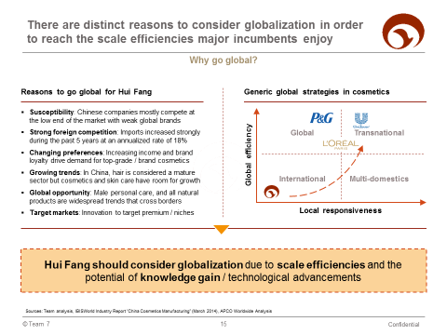
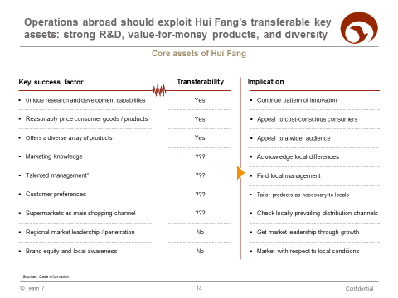
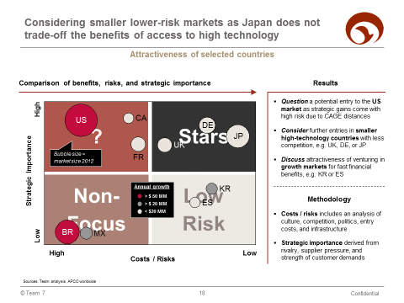
We derive our recommendations by analyzing Hui Fang’s globalization rationale, key success factors, and countries
Global strategy – “WBMH”
Globalization rationale
Key success factors
Country evaluation
  Both scale effects from growth and learning benefits answer the why question …
  … limited transferability of key success factors leads to the necessity to build skills and adapt locally …
  … while the market assessment takes benefits, costs, and risks that we meet abroad into account
  How could Hui Fang enter the US and what would be the NPV? Are there “better” alternatives?
Sources: Team analysis

Slide 19
There are distinct reasons to consider globalization in order to reach the scale efficiencies major incumbents enjoy
Why go global?
Reasons to go global for Hui Fang
Generic global strategies in cosmetics
  Susceptibility: Chinese companies mostly compete at the low end of the market with weak global brands
  Strong foreign competition: Imports increased strongly during the past 5 years at an annualized rate of 18%
  Changing preferences: Increasing income and brand loyalty drive demand for top-grade / brand cosmetics
  Global learning: Processing technology and managerial expertise can increase quality and margins earned
  Global opportunity: Male personal care, and all natural products are widespread trends that cross borders
  Target markets: Innovation to target premium / niches
Global
Transnational
Global efficiency
International
Multi-domestics
Local responsiveness
Hui Fang should consider globalization due to scale efficiencies and the potential of knowledge gain / technological advancements
Sources: Team analysis, IBISWorld Industry Report “China Cosmetics Manufacturing” (March 2014), APCO Worldwide Analysis

Slide 20

Competitors from Japan and South Korea have been successfully in going global – Tactics Hui Fang can adopt
Competitor case studies
Case
Background
Tactic
Result
  Largest manufacturer of cosmetics in Japan with more than 20 brands
  Adopted a well-diversified strategy offering multi-brands in all categories
  Uses retail price as a signal of the category: Premium, Mass-premium, and Mass
  Offered high end retailers such as Bloomingdales and Bullock an exclusive product line
  Segmented their product line into five different age groups and applied targeted marketed tactics
  Product diversification and retail diversification
  By the mid 1980s, Shiseido had bolstered its sales to $75 million annually and was growing by 40% each year
  Overseas operations include about 70 business sites in 70 countries, 10 manufacturing sites and 6 R&D site
  JP → US
  A South Korean cosmetics company focused on developing niche markets
  Expand into high-functional products in major cosmetic categories
  Focused on securing competitiveness through reinforced R&D to provide differentiated products
  Multi-domestic approach due to different levels of industrial and economic development of each country/region
  Limit distribution through only high-end customers to raise their brand prestige
  Penetrate market via direct ownership by hiring local management
  Amore Pacific is currently the number one cosmetic company domestically with 35% market share (2010)
  Overall company stocks grew 127% in 2014 with overseas operations growing 11%
  Successfully entering FR has helped the company capture light in the U.S. market
  KR → FR
Sources: Team analysis, press research, Reference for Business
Notes:
Modern examples next time.

Slide 21
Considering lower-risk markets as Japan does not trade-off the benefits of access to high technology
Attractiveness of selected countries
Comparison of benefits, risks, and strategic importance
Results
?
Stars
  Question a potential entry to the US market as strategic gains come with high risk due to CAGE distances
  Consider further entries in smaller high-technology countries with less competition, e.g. UK, DE, or JP
  Discuss attractiveness of venturing in growth markets for fast financial benefits, e.g. KR or ES
  Methodology
  Costs / risks includes an analysis of culture, competition, politics, entry costs, and infrastructure
  Strategic importance derived from rivalry, supplier pressure, and strength of customer demands
US
CA
DE
JP
UK
Bubble size = market size 2013
FR
Strategic Importance
Low
High
Low Risk
Non-Focus
Annual growth
KR
> $ 50 MM
ES
> $ 20 MM
< $20 MM
BR
MX
High
Low
Costs / Risks
Sources: Team analysis, Euromonitor Beauty & Personal Care 2013 – 2014, Hofstede Index, World Competitiveness Report 2014 – 2015, IBIS Cosmetics Industry Report, IHS Consumer Insights

Slide 22
The market evaluation includes all factors that are crucial for a holistic high-quality comparison
Mainly assessed qualitatively
Details on market evaluation
  Selected markets are the 10 largest in the world – qualitative assessment available upon request
Sources: Team analysis, Euromonitor Beauty & Personal Care 2013 – 2014, Hofstede Index, World Competitiveness Report 2014 – 2015, IBIS Cosmetics Industry Report, IHS Consumer Insights

Slide 23
The US market differs highly from the Chinese market, mainly due to cultural and geographic aspects but also legal issues
Exemplary explanation
US CAGE analysis
Distance
US market distance analysis
In China, cosmetics include anti-aging products with whitening agents; natural ingredients are Chinese Traditional Medicine influences are more desirable
In the US, some firms are incorporating organic, natural, environmentally friendly, and cruelty free items and value can be captured through a well-branded product
Culture
The FDA ensures all products are compliant with Federal Food, Drug and Cosmetic (FD&C) Act.
Hair products, beauty and makeup products are subject to a 1% tariff; pre- or after-shave products, personal deodorants and antiperspirants are subject to a 5% tariff, while perfumed bath sales are subject to a 6% tariff; petroleum jelly products are not subject to any tariffs
Administration
In the US, the main revenue markets are mid-Atlantic and Southeast states and disposable incomes are higher in these regions
American customers shop more often in drug stores and beauty salons for cosmetic products while Chinese customers shop frequently in department store and spas
Geography
American consumers (second largest market) are less brand loyal than Chinese consumers; their choice of cosmetic products varies according to their budgets
Revenue in China is forecast to grow 9% in 2015 as incomes increase and consumers return to buying nonessential items in greater quantities
Economics
Significant distance
No distance
Sources: Team analysis, IBISWorld Industry Report “Global Cosmetics Manufacturing” (July 2014), Cosmeticsbusiness.com
Notes:
http://www.cosmeticsbusiness.com/news/article_page/Natural_in_China/80840

Slide 24
The investment case for Japan is NPV-positive; however, NPV is highly sensitive to key inputs
NPV analysis
Investment case for Japan
Implications
  Japan has the largest cosmetics industry that will provide a steady projected 20% OCF for Hui Fang
  Despite initial outflow of $10.6M in 2015, Hui Fang will have positive cash flow in all subsequent years
  Compared to the US, entering Japan produces a higher NPV proving a more attractive option
  Key Assumptions
  Success in China transferable, i.e. sales growth – thus same channel and demand assumed
  Discount rate as main differencing factor and used as proxy for risk
NPV as sum of present values of FCFs | $ MM
US Case with $1.5 MM NPV at 12% DCR
0.9
1.3
1.6
1.8
2.0
10.6
2.2
2.3
4.0
2.4
NPV
2015
2016
2017
2018
2019
2020
2021
2022
2023+
Sources: Team analysis

Slide 25
Recommendations
Project approach
Recommendations
Global strategy
Internal analysis
Industry analysis
  Provide answers to key questions asked
  Derive recommendations for success abroad
  Suggest entry mode for selected market
  Understand Hui Fang’s global strategy
  Evaluate differences between countries
  Analyze crucial factors for success abroad
  Assess the market and its driving factors
  Understand the industry and the competition
  Analyze cost structures and government policies
  Evaluate Hui Fang’s key success factors
  Assess resources and capabilities
  Check brands for their international potential
Sources: Team analysis

Slide 26


We recommend entering Japan as the same strategic benefits come with higher NPV
Market analysis summary
Trade-offs
Similarities
Conclusions
  Japan is shifting towards foreign entry with organic focus
  Geographic and cultural distance is the most advantageous
  Increasing demand for both organic and high-end cosmetics
  Large overall cosmetics market and demand
  Enter Japan as it presents the biggest pie at the lowest distance and thus risk (high NPV)
  Equal strategic advantages as US
  US growth still high but about to slow down; multi-functionalities key
  Competition is very high and highly focused on price
  Increasing demand for both organic and high-end cosmetics
  Second largest overall cosmetics market / national demand
  Postpone US entry as presents high competition and a multi-functionality trend (low NPV)
  Nonetheless benefits visible
  Germany spends most on color cosmetics
  Presents a smaller, however, less competitive and risky market
  Increasing demand for both organic and high-end cosmetics
  Largest overall cosmetics market in Europe
  Consider Germany as next country to enter as it is a great opportunity to enter Europe at low risk
  Risk-averse option going forward
Sources: Team analysis

Slide 27
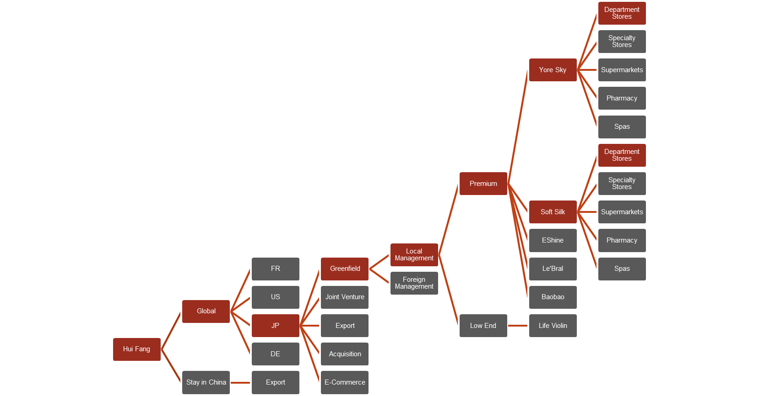
The decision tree focuses on how to enter the Japanese – or US – market in terms of entry mode, product, and channel
How to enter Japan? (1/2)
Decision tree of Hui Fang
Implications
  Entry mode
  Greenfield operations allows HF to control the development of their brand and allows them to protect their intellectual property
  Management
  Local management provides them with local know-how and access to distribution channels
  Sales channels
  Without sales representatives pushing products, there is little purchase consideration for their products
Focus of further analysis
Sources: Team analysis

Slide 28
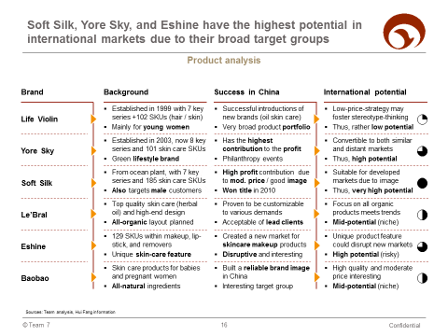
Due to high economic opportunity in Japan, we recommend to establish greenfield operations for Soft Silk and Yore Sky
How to enter Japan? (2/2)
Entry mode analysis
Product analysis
Greenfield / Joint Venture
Export / Joint Venture
Economic opportunity
License / Export
License / Contract
Political risk
Greenfield operations in JP appear sensible due to low political risk and high economic benefits (low NPV → export to US)
Soft Silk and Yore Sky have the largest international potential and meet the “all-organic” trend
Sources: Team analysis

